Slide 1


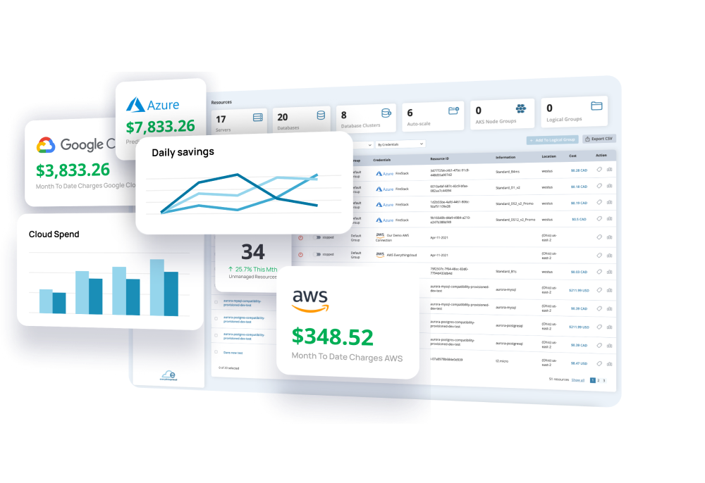

Boost ROI, Cut Costs
Reduce Your Cloud Bill by Up to 60%
Quickly identify areas of overspending and see significant savings.

Slide 2
01 Statistics
01 Statistics
Average organizations cloud waste
35%
Waste in dollars
$253 Billion
Total 2024 global cloud spend
$725 Billion
of something

Slide 3







02 Perspective - $253 Billion Dollars
More than the combined net worth of
Bill Gates and Mark Zuckerberg
$253
Billion
More than the market capitalization of
McDonalds
Larger than the GDP of
New Zealand and Portugal
You could buy All 32 NFL Teams
(Collectively valued at around $140 Billion)
Then still have enough left to buy Netflix

Slide 4
02 Perspective - $253 Billion Dollars
$253
Billion
Over Provisioning
60% - 80%
Idle resources
44%
Unoptimized storage
40%
Orphaned Resources
25% - 30%
Unoptimized Reservations
35%
Third Party Services
25% - 30%
Data transfer
10% to 40%
Misconfigured scaling
20% - 40%
Architecture Change
30% - 60%

Slide 5



Where we live
03 Who is EverythingCloud?
1
In Simple Terms
EverythingCloud specializes in reducing cloud costs and enhancing cloud infrastructure… PERIOD.
1916
2
We are more than just a tool – we are a service backed by real people, offering a second set of eyes and acting as a true partner to ALL our clients.
3
Who We Are
In business 9 Years.
Calgary Canada based.
Specialized in cloud architecture / optimization.
Built tools (over the past 9 years) to help manage our own customers.
Productized our tools into a a SaaS offering / platform.
Bundle all SaaS Subscriptions with EverythingCloud backed “Real People” Analysis.
2024

Slide 6
04 The Secret Sauce
Visibility
Reactive
Proactive
Cloud optimization thrives on:
Complete Visibility
Proactive Maintenance
Rapid Reactive Support
Without these, true efficiency is unattainable.

Slide 7
05 Offering Overview
SaaS Platform
Data Analysis / Reporting
Managed FinOps
Managed Detection and Response
Data / Trend review (Real People)
Monthly reports
Reporting
Automation
Quarterly business alignment meetings
Expert Collaboration / Remediation
The EverythingCloud offering includes a SaaS platform with automated reporting and data analysis, along with expert-led monthly reports and quarterly alignment meetings.
It also features Managed FinOps for reactive detection, response cost optimization

Slide 8
05 Offering Overview
Visibility
SaaS Platform
Data Analysis / Reporting
Managed FinOps
Managed Detection and Response
Data / Trend review (Real People)
Monthly reports
Reporting
Automation
Quarterly business alignment meetings
Expert Collaboration / Remediation
The EverythingCloud offering includes a SaaS platform with automated reporting and data analysis, along with expert-led monthly reports and quarterly alignment meetings.
It also features Managed FinOps for reactive detection, response cost optimization
Proactive
Reactive

Slide 9
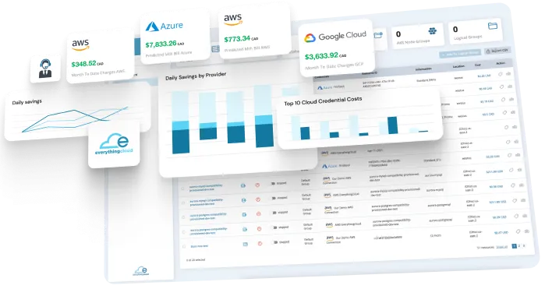
06 SaaS Features (Visibility & Automation)
Orphan Resource Detection
LB, Volumes, Snapshots, Machine Images, IP’s
Detailed Reporting
Cost, New Service, Top 10, Day over Day, etc
Granular Multi-Cloud Management
One Dashboard – All Clouds - All Regions
Recommendations & “Find Better”
Rightsizing, Reservations, Savings Plans,
Better Resources… more
Full Multi Cloud Visibility
Azure, AWS (& GCP soon)
Anomaly & New Service Detection / Alerting
No billing surprises
Advanced Scheduling & Automation
And much more…
Resource scheduling (15 minute increments)
Notification & Override enabled

Slide 10

07 The Human Touch (Proactive)
Data Needs Context
Example: Seasonal businesses: Retail, Tax .
Project / R&D Costs
Monthly Data Review / Report (Tune Up)
Reservation & Savings plan utilization
Budget tracking, service usage review
  Recommendations & Forecasting
Quarterly Business Alignment
Discussion on what's working and what's not
Review of last 3 Month performance
Recommendations and plan for the next 3 months
Architecture Changes
New Offerings (Find Better)
Recommendations regardless of platform or service

Slide 11
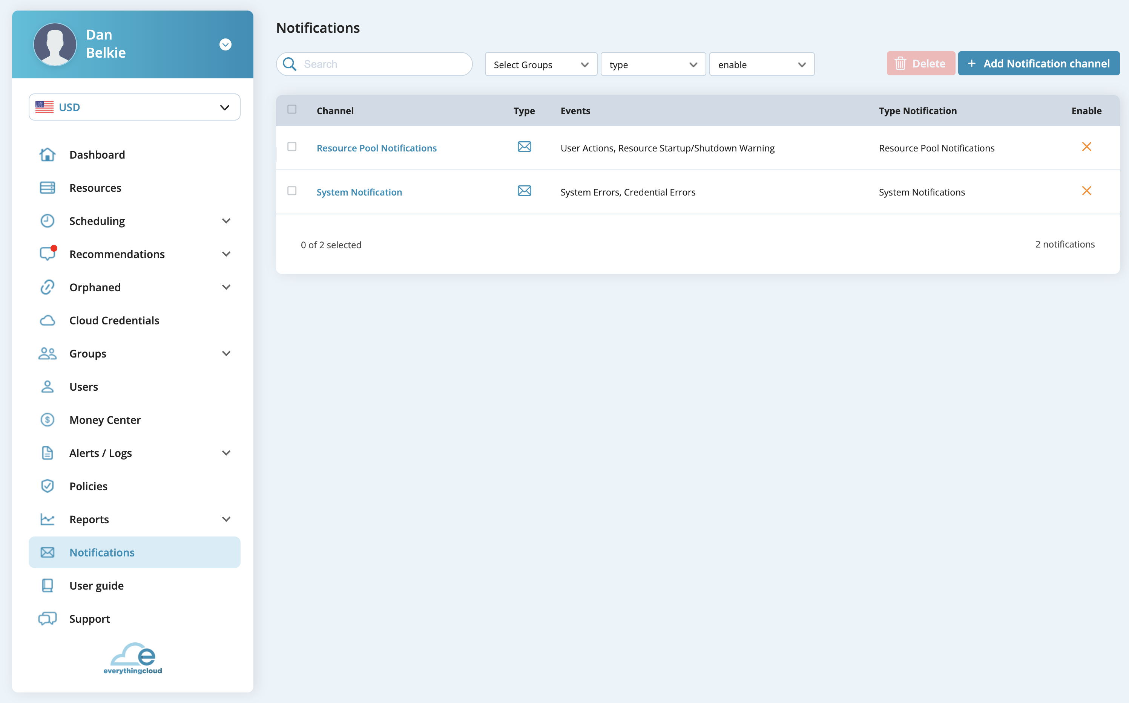
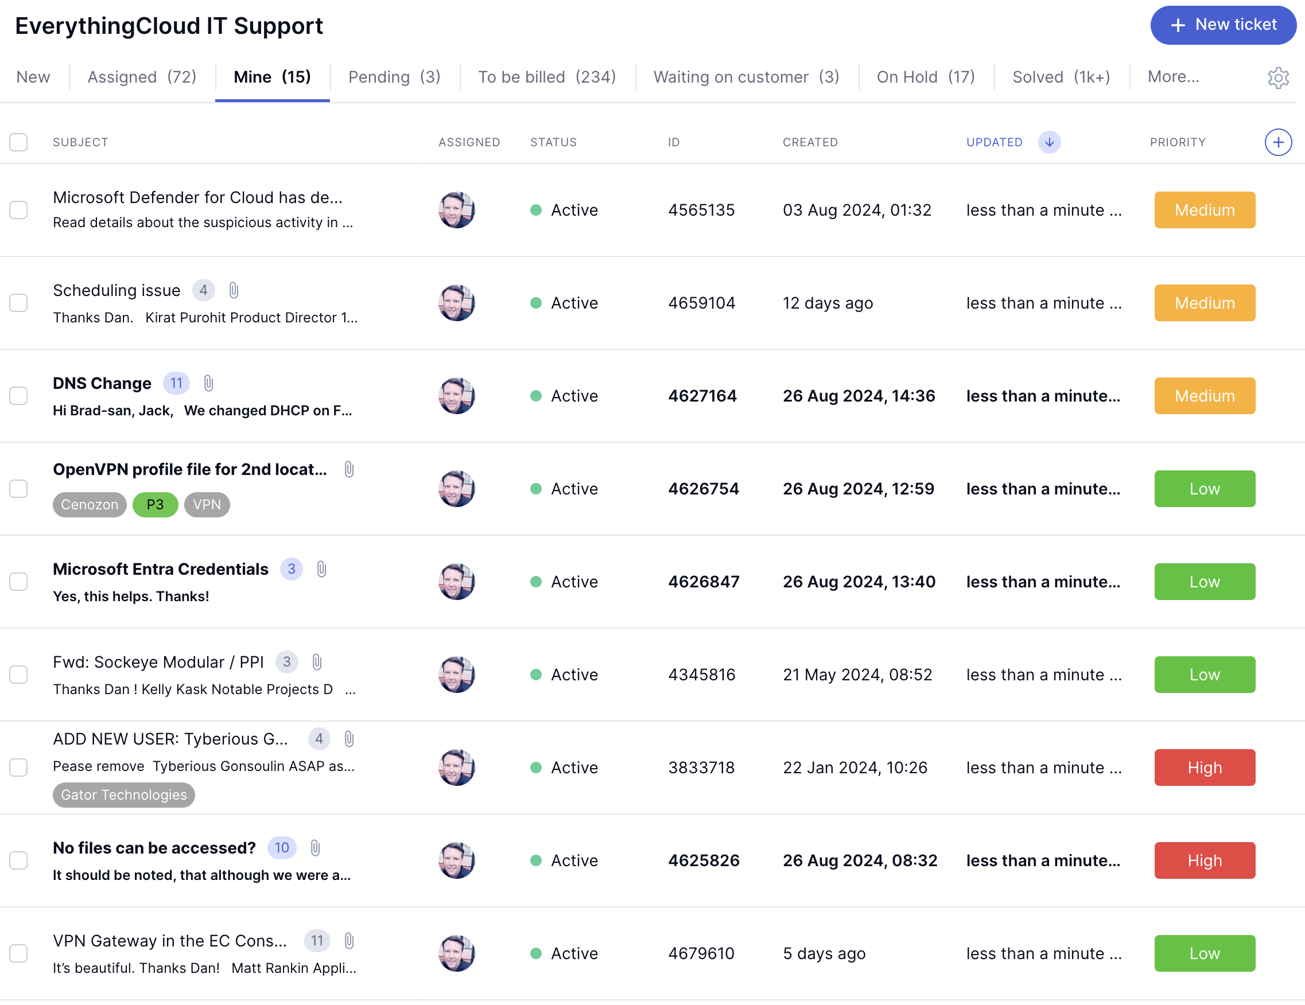
08 Managed FinOps (Reactive)
Comprehensive
Managed detection & Response
Real time monitoring across multiple platforms
EverythingCloud managed with customer escalation
Immediate action plans and SOPs
Alerting, Remediation & Escalation
All alerts are tracked via tickets in your portal
Immediate execution of action plans and SOPs
Integrated Insights & Visibility
All Managed FinOps operations are seamlessly integrated into the SaaS portal, ensuring a unified experience.

Slide 12
09 Pricing
All customers start with an initial onboarding, which includes an environment review and discovery meetings. The cost of onboarding is based on your monthly cloud spend, as outlined in the table below.
PRICING | Cloud Spend | Onboarding Price | Monthly Service Price
Level 1 | $0 - $49,999 | $2,000 | $1,300
Level 2 | $50,000 - $99,999 | $3,000 | $1,800
Level 3 | $100,000 - $149,999 | $4,000 | $2,300
Level 4 | $150,000 - $199,999 | $5,000 | $2,800
Level 5 | $200,000 - $299,999 | $7,000 | $3,800
Level 6 | $300,000 - $399,999 | $8,000 | $4,800
Level 7 | $400,000 - $499,999 | $10,000 | $5,800
Level 8 | $500,000 - $699,999 | $12,000 | $7,800
Level 9 | $700,000 - $899,999 | $14,000 | $9,800
Level 10 | $900,000 - $999,999 | $15,000 | $10,800
Custom | $1,000,000+ | Get in Touch
This is all inclusive support that covers: Proactive Support, Monthly Reports, Quarterly Business Objective Meetings, and 24/7 Managed FinOps.
* All prices are in USD.

Slide 13
10 Open Discussion
Do you know your current cloud waste?
28%
17%
48%

Slide 14
11 Next Steps – What does Onboarding look like?
Simple Setup:
Configuration complete in less than 30 minutes.
1
Configure Access
2
Collect / Review
3
Present Finding
Configure platform read-only access: IAM custom roles / Service principles.
Typical 2-week collection.
Present findings in presentation style / report.
Discuss business objectives.
Portal / Programmatic read-only account.
Define SOPs for Managed FinOps.
EverythingCloud User account configuration.

Slide 15




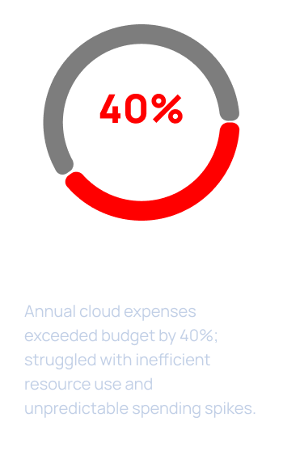
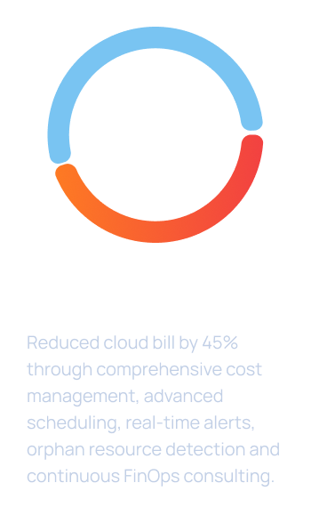


12 Case Study
We were already doing quite well, but
EverythingCloud took us to the next level.
Despite our strong performance, our annual cloud costs were consistently over budget.
EverythingCloud’s team stepped in and revolutionized our cloud management approach.
As a result, we’ve not only significantly reduced our cloud spend, but also achieved proper spending predictability.
EverythingCloud has been a game-changer for us. I’m truly impressed by the results.
Invico Multi-cloud:
Allison Taylor
CEO, Invico Corp

Slide 16
13 Discussion

